Slide 1
SMART GARDENING AND
PLANT DISEASE DETECTION USING LoRaWAN
Roll Number | Full Name
02 | AFROOS SHAHANA T
06 | FATHIMA NIDHA
07 | MUHAMMED ANAS K
11 | SWALIH T
Group No 03
1
B.Tech Main Project : 2020-2021
Saturday, January 16, 2021
1

Slide 2
Outline
Introduction
Literature Survey
Comparison Table
Proposed system
Need of the topic
Methodology and block diagram
Overview of the block diagram
Results
Conclusion
Future Scope
References
2
2
B.Tech Main Project : 2020-2021
Saturday, January 16, 2021

Slide 3
Introduction
Internet of Things means Internetworking of physical devices which are embedded .
It creates an opportunity about direct interaction of physical world with computer system world .
Agriculture is the backbone and one of the important human activity of our nation.
3
B.Tech Main Project : 2020-2021
Saturday, January 16, 2021

Slide 4
In agricultural sector, water is the most used resource.
Irrigation helps to save large amount of water.
Manual irrigation is the traditional method used in agricultural land and may require expert labours on larger farm.
4
B.Tech Main Project : 2020-2021
Saturday, January 16, 2021

Slide 5
In this work, an automated smart irrigation system along with plant disease and fruit maturity detection using IOT.
Various modern technologies have emerged to minimize
postharvest processing, to fortify agricultural sustainability
and to maximize the productivity.
B.Tech Main Project : 2020-2021
Saturday, January 16, 2021

Slide 6
Literature Survey
A Low Cost Smart Irrigation Control System
In this work forthput a low cost system which can be affordable by Indian farmers.
To control the water motor automatically along with detection of where water is needed and in what quantity more using soil moisture sensor.
Local Shortest Path (LSP) is the algorithm which used for controlling the wireless multiple networks.
B.Tech Main Project : 2020-2021
Saturday, January 16, 2021

Slide 7
Literature Survey
2. Automatic Crop Irrigation System
Proposed an automatic crop irrigation system in this system there will be monitoring of various factors like humidity, temperature and indicating water level.
Using GSM technique transfer of data takes place and messages will be sent on the mobile of the farmer.
It also uses temperature and soil moisture sensors.
B.Tech Main Project : 2020-2021
Saturday, January 16, 2021

Slide 8
Literature Survey
3. New Optimized Spectral Indices for Identifying and Monitoring Winter Wheat Diseases
Taken three different pests (Powdery mildew, yellow rust and aphids) in winter wheat for their observance.
The most and the least specific wavelengths for different diseases have been extracted using RELIEF-F algorithm.
B.Tech Main Project : 2020-2021
Saturday, January 16, 2021

Slide 9
Literature Survey
4. Image Processing for Smart Farming:Detection of Disease and Fruit Grading
The need to effectively grow a plant and increase its yield is very important. In order to do so, it is important to monitor the plant during its growth period, as well as, at the time of harvest.
In this paper image processing is used as a tool to monitor the diseases on fruits during farming, right from plantation to harvesting.
B.Tech Main Project : 2020-2021
Saturday, January 16, 2021

Slide 10
Literature Survey
5.Leaf Disease Detection and Grading using Computer Vision
Technology &Fuzzy Logic
K-means clustering used to segment the defected area; GLCM is used for the extraction of texture features, Fuzzy logic is used for disease grading.
B.Tech Main Project : 2020-2021
Saturday, January 16, 2021

Slide 11
Literature Survey
6.sensor based automated irrigation system.
In this paper MAX232 dual driver/receiver, GPS, WSNs and microcontroller are used.
All of these connected by the internet controls the entire system. The
system is very efficient in a large scale, but its costeffectiveness reduces when applied in relatively small fields or
gardens.
B.Tech Main Project : 2020-2021
Saturday, January 16, 2021

Slide 12
Comparison Table
Sr. No. | Title | Methodology | Advantages | Disadvantage
1. | A Low Cost Smart Irrigation Control System | Local shortest path | Affordable | Used both Arduino & Raspberry pi
2. | Automatic Crop Irrigation System | Using GSM | Water conservation | Software code is changing for every crop.
3. | New Optimized Spectral Indices for Identifying and Monitoring Winter Wheat Diseases | RELIEF -F algorithm | Different diseases on the crop is identified | Is not possible when using existing indices that are sensitive to abiotic stress conditions.
B.Tech Main Project : 2020-2021
Saturday, January 16, 2021

Slide 13
Sr. No. | Title | Methodology | Advantages | Disadvantages
4. | Image Processing for Smart Farming:Detection of Disease and Fruit Grading | Using ANN & Back propagation network is mentioned | Spreading of disease is detected. | Quality of image may be lost
5. | 5.Leaf Disease Detection and Grading using Computer Vision Technology &Fuzzy Logic | K means clustering is used | Fuzzy logic is used for disease grading | Long process
B.Tech Main Project : 2020-2021
Saturday, January 16, 2021

Slide 14
Sr. No. | Title | Methodology | Advantages | Disadvantages
6. | Sensor based automated system | MAX232 dualdriverreceiver, GPS,WSNs and microcotroller are used. | Effective in large scale | Not affordable for small scale.

Slide 15
Proposed System
Irrigation
It consists of one central LoRa module, different types of sensors, relay modules, water pump.
The sensors are placed in various positions on land.
Here we use ESP 32TTGOLoRa module.
The ESP32 TTGO LoRa board is programmed using Arduino IDE. The required libraries can be downloaded from Github . To connect the board to the Windows, Linux or OSX systems, CP2102 USB to UART bridge should be installed on the system which is provided by silicon.
B.Tech Main Project : 2020-2021
Saturday, January 16, 2021

Slide 16
The audience in the field is also connected to a servo motor, so that it can control the water supplying gate.
The arduino goes through each IP listed in it, requests for data, then it receives the data and processes them.
A GSM shield to connect to the internet and communicate with the administrator.
B.Tech Main Project : 2020-2021
Saturday, January 16, 2021

Slide 17
If the conditions are met, commands the relay module to activate the water pump for a specified duration after which the computer commands the relay module to stop the pump.
Disease Detection
The detection of plant diseases is done through a machine learning tool called WEKA.(Waikato Environment for Knowledge Analysis)
Weka is a collection of machine learning algorithms for data mining tasks. It contains tools for data preparation, classification, regression, clustering, association rules mining, and visualization. Weka is open source software issued under the GNU General Public License.
B.Tech Main Project : 2020-2021
Saturday, January 16, 2021

Slide 18
Need of the topic
Whenever we go from home, we used to get worried about plants because they need water on regular basis.
We gone through several options to solve this problem as plants need water according to the moisture level of soil.
So we have made Automatic Plant Watering System Using Things Arduino .

Slide 19
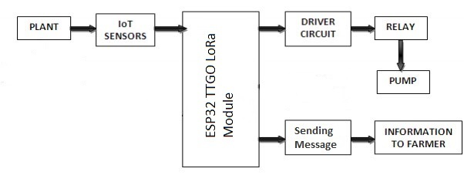
Methodology and block diagram
Irrigation

Slide 20
Overview of the Irrigation module with block diagram
In this system, soil moisture sensor senses the moisture level of the soil.
If soil will get dry then sensor senses low moisture level and automatically switches on the water pump to supply water to the plant.
As plant get sufficient water and soil get wet then sensor senses enough moisture in soil. After which the water pump will automatically get stopped.

Slide 21
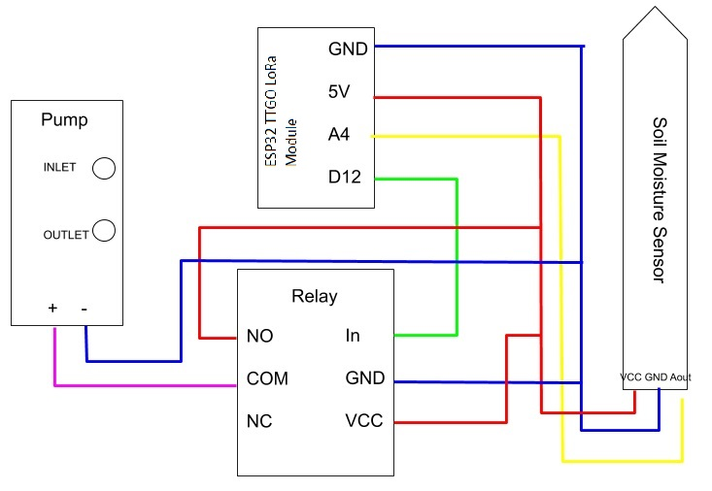
Irrigation- System Design & Implementation

Slide 22
Disease detection
Here we use soyabean leaf to detect the disease.The dataset of soyabean consist of 683 instances ,30 attributes and 19 classes.
The processed data in Weka can be analyzed using different data mining techniques like, Classification, Clustering, Association rule mining, Visualization etc. algorithms.
The information can be extracted with respect to two or more associative relation of data set. Here we use two data mining algorithms .They are Naive bayer’s and Multilayer perceptron algorithms.

Slide 23
System Design & Implementation(contd)
Data can be imported from a file in various formats: ARFF, CSV, C4.5, binary.
Data can also be read from a URL or from an SQL database (using JDBC)
Pre-processing tools in WEKA are called “filters”
The dataset in WEKA :Each entry in a dataset is an instance of the java class weka.core.Instance.

Slide 24
Naive Bayes
Naive Bayes implements the probabilistic Naïve Bayes classifier.
Naïve Bayes Simple uses the normal distribution to model numeric attributes.
This can use kernel density estimators, which improve performance if the normality assumption if grossly correct; it can also handle numeric attributes using supervised discretization.

Slide 25
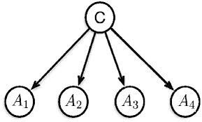
Naïve Bayes updateable is an incremental version that processes one request at a time. It can use a kernel estimator but not discretization.

Slide 26
Multi layer perceptron
The Multilayer Perceptron (MLP) which is also called as Feed Forward Artificial Neural Network.
It consists of appropriate nodes by directed graphs; here every node is connected to a node.
The node is a neuron with nonlinear functions. To training a network which uses the back propagation algorithms also it is not linearly separable.

Slide 27
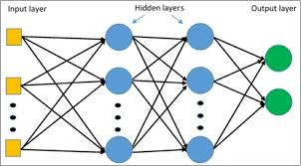
A weighted inputs will map the each neurons output. Any number of layers can be reduced to a two-layer input and output model.

Slide 28
Parameter Evaluation
i) Mean Absolute Error: The mean absolute error (MAE) is a quantity used to measure predictions of the absolute errors. MAE is given by
MAE = SAE / N
Where SAE= the sum of the absolute errors
N= the number of non-missing data points
ii) Root Mean Squared Error: It is the square root of the mean of the squares of the values. It squares the errors before they are averaged and RMSE gives a relatively high weight to large errors.
N= the number of non-missing data points

Slide 29
iii) TP-Rate: It is known as true positive rate and is calculated as
TP-Rate= TP/ (TP+FN)
iii) TN-Rate: It is known as true negative rate and is calculated as
TN-Rate= TN/ (TN+FP)
iv) FP-Rate: It is known as false positive rate and is
calculated as
FP-Rate= FP/ (FP+TN)

Slide 30
v) FN-Rate: It is known as false negative rate and is calculated as
FN-Rate= 1-TP-Rate
vi) PRECISION = TP/ (TP+FP)
vii) RECALL= TP/ (TP+FN)
viii) ROC: Receiver Operating Characteristic Curve is a graphical plot equating the tp-rates and the fp rates of a classifier as the refinement threshold of the classifier is different.

Slide 31
Coding
// if the soil is dryer than this number, then start watering
const int dry = 270;const int pumpPin = 12;const int soilSensor = A4;
void setup() {
pinMode(pumpPin, OUTPUT);
pinMode(soilSensor, INPUT);
Serial.begin(9600);
digitalWrite(pumpPin, HIGH);
delay(5000);}
void loop() {
// read current moisture
int moisture = analogRead(soilSensor); Serial.println(moisture); delay(5000);

Slide 32
If (moisture >= dry) {
// the soil is too dry, water!
Serial.println("Watering starts now..moisture is " + String(moisture));
digitalWrite(pumpPin, HIGH);
// keep watering for 5 sec
delay(5000);
// turn off water
digitalWrite(pumpPin, LOW);
Serial.println("Done watering.");
} else {
Serial.println("Moisture is adequate. No watering needed " + String(moisture));
}
}

Slide 33
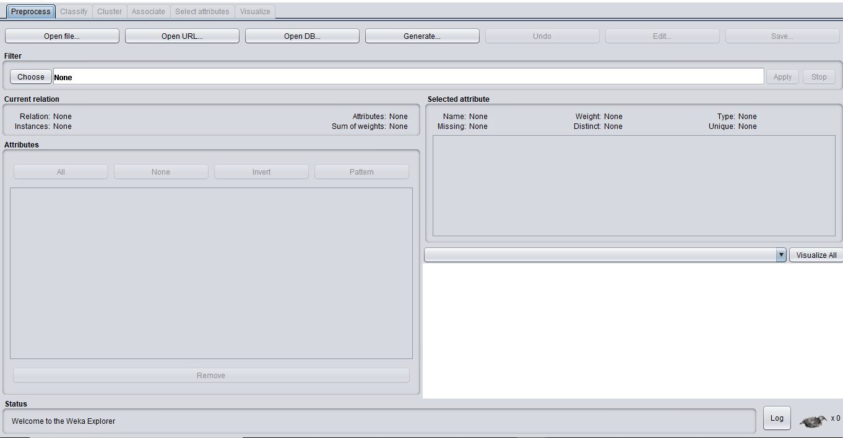
Disease Detection

Slide 34
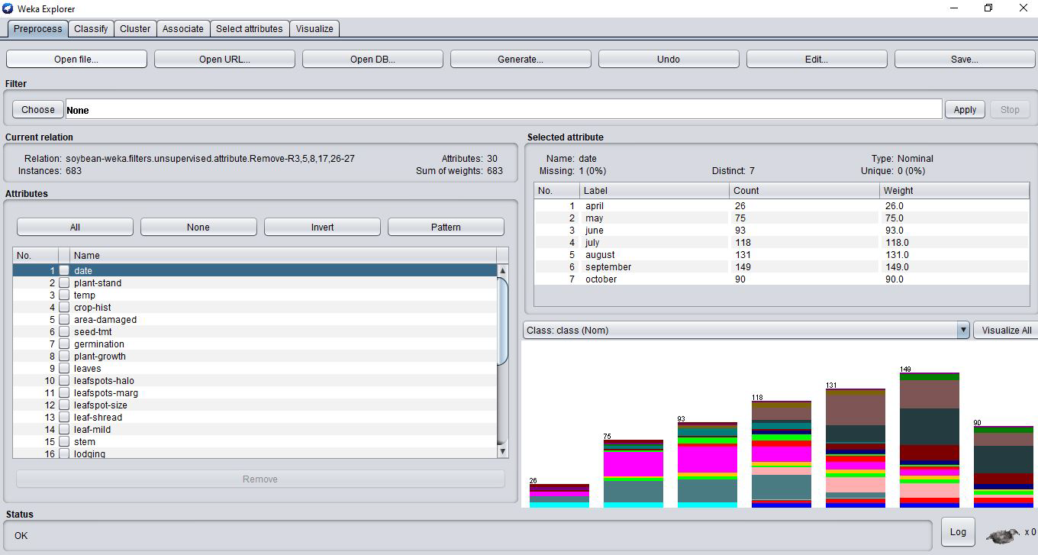

Slide 35
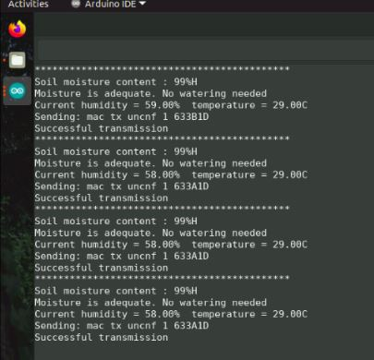
Result - Irrigation

Slide 36
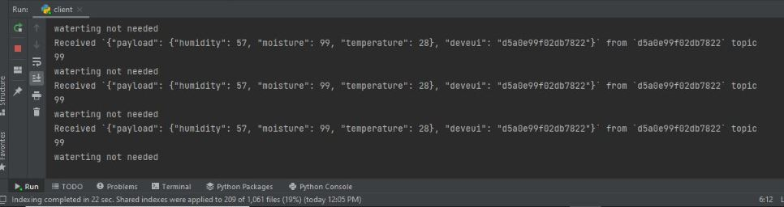

Slide 37
Result- Disease Detection
In the phase for finding the best order of defects. If N images are used class for training then other images are used for testing. The accuracy of the proposed approach is defined as,
Total accuracy (%) = (Number of images correctly classified
/ Total number of images used for testing) * 100
Execution Time
Execution time is defined as difference of end time when
algorithm stops performing and start time
Execution time = End time of algorithm- start of the algorithm

Slide 38
Confusion matrix
TP rate | FP rate | precision | Recall | F-mea- sure | MCC | ROC Area | PRC Area | Class
1.000 | 0.005 | 0.870 | 1.000 | 0.930 | 0.930 | 1.000 | 1.000 | diaporthe-stem-canker
0.950 | 0.006 | 0.826 | 0950 | 0.884 | 0.882 | 1.000 | 0.993 | charcoal-rot
1.000 | 0.002 | 0.952 | 1.000 | 0.976 | 0.975 | 1.000 | 1.000 | rhizoctonia-root
1.000 | 0.005 | 0.967 | 1.000 | 0.983 | 0.981 | 1.000 | 1.000 | phytophthora-root
0.977 | 0.003 | 0.956 | 0.977 | 0.966 | 0.964 | 1.000 | 0.999 | brown -stem-rot
1.000 | 0.003 | 0.909 | 1.000 | 0.952 | 0.965 | 1.000 | 1.000 | powdery mildew
1.000 | 0.000 | 1.000 | 1.000 | 1.000 | 1.000 | 1.000 | 1.000 | downy-mildew
0.815 | 0.017 | 0.882 | 0.815 | 0.847 | 0.990 | 0.990 | 0.944 | brown-spot
0.950 | 0.003 | 0.905 | 0.950 | 0.927 | 1.000 | 1.000 | 0.988 | bacterial-blight

Slide 39
TP rate | FP rate | precision | Recall | F-mea- sure | MCC | ROC Area | PRC Area | Class
0.900 | 0.000 | 1.000 | 0.900 | 0.947 | 0.974 | 1.000 | 0.993 | bacterial-pustule
1.000 | 0.000 | 1.000 | 1.000 | 1.000 | 1.000 | 1.000 | 1.000 | purple seed stain
0.955 | 0.003 | 0.955 | 0.955 | 0.955 | 0.951 | 1.000 | 0.995 | anthracnose
0.250 | 0.018 | 0.294 | 0.250 | 0.270 | 0.251 | 0.967 | 0.426 | phyllostica leaf spot
0.989 | 0.056 | 0.732 | 0.989 | 0.841 | 0.825 | 0.990 | 0.930 | alternaria leaf
0.741 | 0.007 | 0.942 | 0.741 | 0.813 | 0.798 | 0.976 | 0.895 | frog eye leaf-spot
1.000 | 0.001 | 0.938 | 1.000 | 0.968 | 0.968 | 1.000 | 1.000 | diaporthe pod stemblig
1.000 | 0.000 | 1.000 | 1.000 | 1.000 | 1.000 | 1.000 | 1.000 | cystnematode
0.125 | 0.001 | 0.667 | 0.125 | 0.211 | 0.282 | 0.992 | 0.574 | 2 4 d injury
1.000 | 0.000 | 1.000 | 1.000 | 1.000 | 1.000 | 1.000 | 1.000 | herbicide injury
0.883 | 0.013 | 0.885 | 0.883 | 0.874 | 0.868 | 0.993 | 0.941

Slide 40
TP rate | FP rate | precision | Recall | F-mea- sure | MCC | ROC Area | PRC Area | Class
1.000 | 0.002 | 0.952 | 1.000 | 0.976 | 0.975 | 1.000 | 1.000 | diaporthe-stem-canker
1.000 | 0.000 | 1.000 | 1.000 | 1.000 | 1.000 | 1.000 | 1.000 | charcoal-rot
0.950 | 0.000 | 1.000 | 0.950 | 0.974 | 0.974 | 1.000 | 1.000 | rhizoctonia-root
1.000 | 0.002 | 0.989 | 1.000 | 0.994 | 0.994 | 1.000 | 1.000 | phytophthora-root
1.000 | 0.000 | 0.978 | 1.000 | 0.989 | 0.988 | 1.000 | 1.000 | brown -stem-rot
1.000 | 0.000 | 1.000 | 1.000 | 1.000 | 1.000 | 1.000 | 1.000 | powdery mildew
1.000 | 0.019 | 1.000 | 1.000 | 1.000 | 1.000 | 1.000 | 1.000 | downy-mildew
0.848 | 0.005 | 0.876 | 0.848 | 0.862 | 0.841 | 0.988 | 0.927 | brown-spot
1.000 | 0.000 | 0.870 | 1.000 | 0.930 | 0.930 | 1.000 | 1.000 | bacterial-blight

Slide 41
TP rate | FP rate | precision | Recall | F-mea- sure | MCC | ROC Area | PRC Area | Class
0.900 | 0.000 | 1.000 | 0.900 | 0.947 | 0.947 | 1.000 | 1.000 | bacterial-pustule
1.000 | 0.000 | 1.000 | 1.000 | 1.000 | 1.000 | 1.000 | 1.000 | purple seed stain
0.977 | 0.000 | 1.000 | 0.977 | 0.989 | 0.988 | 1.000 | 1.00 | anthracnose
0.300 | .018 | 0.333 | 0.300 | 0316 | 0.297 | 0.947 | 0.306 | phyllostica leaf spot
0.868 | 0.029 | 0.823 | 0.868 | 0.845 | 0.821 | 0.988 | 0.928 | alternaria leaf spot
0.791 | 0.027 | 0.818 | 0.791 | 0.804 | 0.775 | 0.982 | 0.920 | frog eye leaf-spot
1.000 | 0.001 | 0.938 | 1.000 | 0.968 | 0.968 | 1.000 | 1.000 | diaporthe pod stem blight
1.000 | 0.000 | 1.000 | 1.000 | 1.000 | 1.000 | 1.000 | 1.000 | cyst-nematode
1.000 | 0.000 | 1.00 | 1.000 | 1.000 | 1.000 | 1.000 | 1.000 | 2-4-d injury
1.000 | 0.00 | 1.000 | 1.000 | 1.000 | 1.000 | 1.000 | 1.00 | herbicide,,

Slide 42
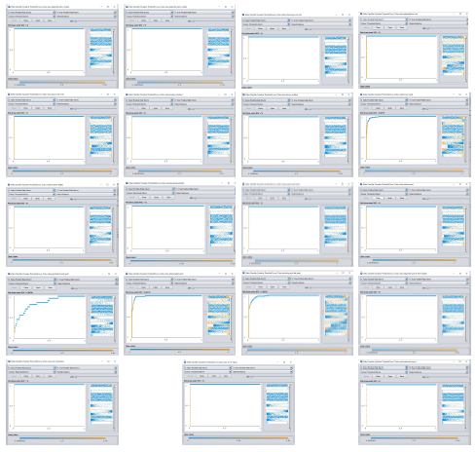
ROC Curves
Naïve Bayes Classifier

Slide 43
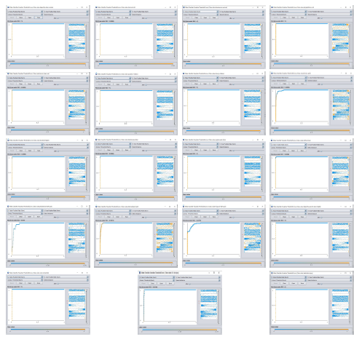
Multilayer Perceptron Graph

Slide 44
Overview of the result of Disease Detection
By the calculation of accuracy and the execution time ,the accuracy of Multilayer perceptron is higher than Naive Bayes and the execution time of MLP is higher.The higher execution time has higher accuracy.So we choose MLP has a best way to detect the disease of a plant.

Slide 45
Conclusion
The system follows a systamatic and scientific approach taking care of plants which can dramatically improve productivity.
Thesystem can easily made and not very costly. The farmers can reduce their workload.This system can reduce water wastage.
Plant disease detection to have the accuracy in the plant disease detection but at the same time the process should be of high speed.
Work can be extended by the use of quad copter for the capturing images of leaves of the different plants in the farm at feild.

Slide 46
Future scope
The future goal is to train all plant species. The code already drone compatible and ready for real-time video capture.
In future it can be used for real-time capture and immediate processing of the field.
The future aspect of this model can be made into an intelligent system, where in the system predicts user actions, rainfall pattern, time to harvest and many more features which will make the system independent of human operation.
Systems can all be upgraded to Real Time systems such that users receive real time updates and status of condition of the field. Thereby, enabling the user to take immediate action in case of any problems

Slide 47
References
[1] S. S. Sannakki and V. S. Rajpurohit,” Classification of Pomegranate
Diseases Based on Back Propagation Neural Network,” International
Research Journal of Engineering and Technology (IRJET), Vol2 Issue:
02 | May-2015
[2] Aakanksha Rastogi, Ritika Arora and Shanu Sharma,” Leaf Disease Detection and Grading using Computer Vision Technology Fuzzy Logic” 2nd International Conference on Signal Processing and
Integrated Networks (SPIN)2015

Slide 48
[3] Suraj S.Avatade, Prof.S. P. Dhanure, “Irrigation System
Using a Wireless Sensor Network and GPRS”, International
Journal of Advanced Research in Computer and Communication
Engineering, Vol. 4, Issue 5, May 2015.
[4] Gutiérrez, Joaquín, et al. "Automated irrigation system using
a wireless sensor network and GPRS module." IEEE transactions on instrumentation and measurement 63.1 (2014): 166-176.
[5] Kansara, Karan, Vishal Zaveri, Shreyans Shah, Sandip
Delwadkar, and Kaushal Jani. "Sensor based Automated
Irrigation System with IOT: A Technical Review."

Slide 49
[6] uan Tian, Chunjiang Zhao, Shenglian Lu and Xinyu Guo,” SVM-based Multiple Classifier System for Recognition of Wheat Leaf Diseases,” Proceedings of 2010 Conference on Dependable Computing (CDC’2010), November 20-22, 2010.
[7] Barbedo, J.G.A., Godoy, C.V., ‘Automatic Classification of Soybean
Diseases Based on Digital Images of Leaf Symptoms’, SBI AGRO,
2015.

Slide 50
Thank You

